Slide 1
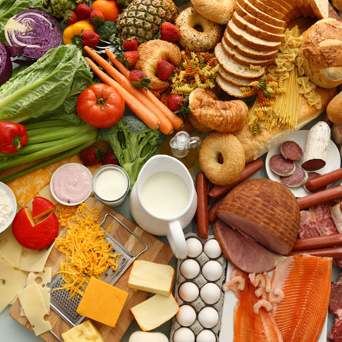
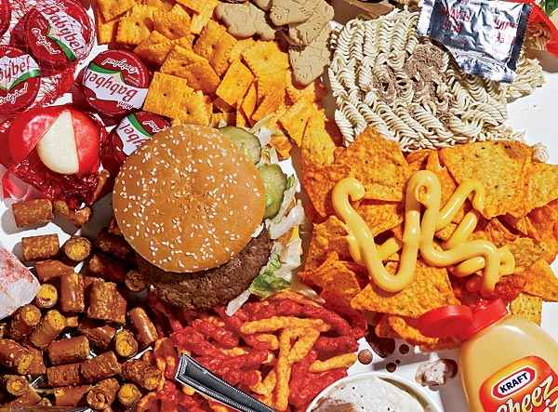
Good Food Bad Food
What will it take to get Americans to change their eating habits?

Slide 2
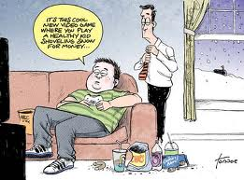
What’s the Author’s Point?

Slide 3
Quickwrite #1
Write for 5 minutes about the following question:
Americans are at increasing risk of disease because of the unhealthy foods we eat. What will it take to get us to change our eating habits? (At least ½ page)

Slide 4
How Many M&M’s Did you eat??
On the bottom of your QW, write down how many M&Ms you ate:_____
M&Ms

Slide 5
Qyickwrite #2
Would you have eaten as many M&Ms if I had told your before you ate them how much effort it would take to burn them off? Why or why not?

Slide 6
Should food labels include exercise 'equivalents'? By Carina Storrs, CNN April 7, 2016
Imagine you're choosing between two different boxes of cookies at the grocery store. One has a label informing you that you could burn off the calories in a serving by jogging for 10 minutes, while the label on the other box says you would have to jog for 20 minutes. Would that help you decide which cookie to buy?
Although the idea of these types of food labels has not really picked up steam in the United States, the Royal Society for Public Health, an organization of health care professionals in the United Kingdom, is advocating these "activity equivalent" labels. They would tell consumers how many minutes they would have to engage in several types of exercise, such as walking and jogging, to expend the calories in specific food items.
Would this make a difference?
Is this an effective solution to propose?

Slide 7
Exercise Equivalents
Go to:
http://www.cnn.com/2016/04/07/health/food-label-activity-equivalents/
Read the article, browse the different foods and their exercise equivalents
Go http://www.dailymail.co.uk/femail/food/article-3513716/How-exercise-REALLY-takes-burn-Big-Mac.html
Find your favorite Fast Food meal or equivalent and determine how much exercise it would take to burn off.
Quickwrite #3-Would having this info affect whether or not you eat your favorite fast food meal? Why or why not? Is this an effective solution to propose?

Slide 8
Making Predictions: Anticipation Guide
Fill out the “Before Reading” column of the “Anticipation Guide” by considering your own beliefs and knowledge about the causes and possible solutions for the obesity epidemic.
After we read the articles you will be reconsider these ideas by filing out the second column and indicate which text, paragraph and information informed your opinion by completing the third and fourth column.

Slide 9
Anticipation Guide

Slide 10
Surveying the TextS
What do the titles “Attacking the Obesity Epidemic by First Figuring out Its Cause” and “Bad food? Tax it, and subsidize Vegetables” tell you about what the articles will be about?
Can you guess what “No Lunch Left Behind” is going to be about from its title?
All three articles were published in the NYT in 2009 and 2011. What can you predict about the articles? How do you think the articles will be similar? Different?
On the title page for this module, write a definition for “Good Food.” Now write one for “Bad Food.”

Slide 11
Making Predictions & Asking Questions
Read the first five paragraphs of “Bad Food? silently” and then discuss the following questions:
Now that you’ve read the first five paragraphs of “Bad Food,” what is it going to be about? Why does Bittman put a question mark after “Bad Food?”
Who do you think is the intended audience for this piece? How do you know this? Is this the same as the audience for “No School Lunch Left Behind”?
Turn the title of Bittman’s article into a question to answer as you read the essay.

Slide 12
Annotating the Text
Annotating a text enables readers to explore more deeply how a text works to inform or persuade its readers. During the initial reading, you read “with the grain” and “played the believing game.” In the left-hand margin, label what the author is saying as follows:
The introduction- Where does it end? Summarize.
The issue or problem -Where does Bittman state it? Recap.
The author’s main arguments (reasons) - Label them. What are they?
The author’s examples- Label them. Summarize.
The counterarguments –What are they? How are they rebutted?
The author’s conclusion- Where does it begin? What insights or
solutions are offered?

Slide 13
Questioning the Text
In rereading, it is helpful to read “against the grain,” or “play the doubting game.” This is where the conversation about solving the obesity epidemic shifts, and you should begin to question the texts and their authors. As you finish rereading “Bad Food?” make marginal notations regarding your reactions to what the author is saying. You can:
ask questions
express surprise
disagree
elaborate
note any moments of confusion
***add at least 5 questions or new reactions to your notes from your first read
When you finish, exchange your copy with a partner. Read your partner’s annotations, and then talk about what you chose to mark and how you reacted to the text. Did you agree on what the main idea was? Did you mark the same arguments and examples? Did you agree on the conclusion? How did your responses differ?

Slide 14
Real World Example in action
Philly Soda Tax
After reading Bittman and watching this news clip, what is your initial reaction to the idea of taxing unhealthful foods and using the revenue to subsidize other needed, healthy programs?

Slide 15
Compare your NOtes
When you finish, exchange your copy with a partner.
Read your partner’s annotations, and then talk about what you chose to mark and how you reacted to the text.
Did you agree on what the main idea was?
Did you mark the same arguments and examples?
Did you agree on the conclusion?
How did your responses differ?

Slide 16
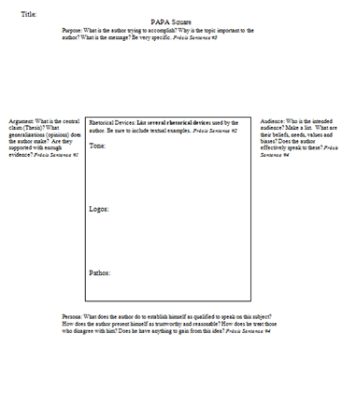
Whole Class PAPA Square and Precis

Slide 17
TED Talk
Jamie Oliver's "Teach Every Child About Food“
Using the Rhetorical Triangle Notes, compose a 5 sentence Rhetorical Precis that outlines Oliver’s argument.
For the 5th sentence, select one solution Oliver offers and state whether you agree or disagree with it and WHY.

Slide 18
Reading for Understanding
As we read, use highlighters to Colormark Brody’s use of Ethos, Pathos and Logos.
Where and how does Brody establish herself as credible?
Where and how does she make the subject matter to the audience?
Where and how does she use logic to persude her audience?
Is there a balance between the three types of appeals?

Slide 19
Small Group PAPA Square and Rhetorical Precis
With your group, complete a PAPA Square, then use that analysis to compose a Rhetorical Precis
Work collaboratively
Everyone writes on their own copy

Slide 20
Making Predictions & Asking Questions
Quickwrite: Do you eat healthy lunches when you are at school? Why or why not? Describe a typical lunch. ½ page
Read the first paragraph of “No Lunch Left Behind” silently.
What do Waters and Heron think should happen to school lunches?
Now that you’ve read the first paragraph, explain what the title of the article means.

Slide 21
Reading for Understanding
The first reading of an essay is intended to help you understand the text and confirm your predictions. This step is sometimes called reading “with the grain” or “playing the believing game.” As you read, think about the following questions:
Which of your predictions turned out to be true?
What surprised you?
If your predictions turned out to be wrong, what misled you?
Can you answer the question you created from the title?
What, if anything, is still confusing to you?

Slide 22
descriptive outlining
No Lunch Left Behind
By ALICE WATERS and KATRINA HERON
This new era of government bailouts and widespread concern over wasteful spending offers an opportunity to take a hard look at the National School Lunch Program. Launched in 1946 as a public safety net, it has turned out to be a poor investment. It should be redesigned to make our children healthier.
Content:
What are the authors saying? (Paraphrase / summarize)
The National School Lunch Program is a failure and should be reformed to improve children’s health.
Purpose:
Why did the authors provide this content?
The purpose is to make a recommenda-tion for how to improve children’s health based on the lunch they are provided at school.

Slide 23
Considering Structure
How are the authors’ arguments ordered? (Which arguments come first, in the middle, last?) What is the effect of this on the reader?
How has the structure of the text helped make the argument clear, convincing, and engaging?

