Slide 1
Independent Reading Projects
Directions & Models

Slide 2
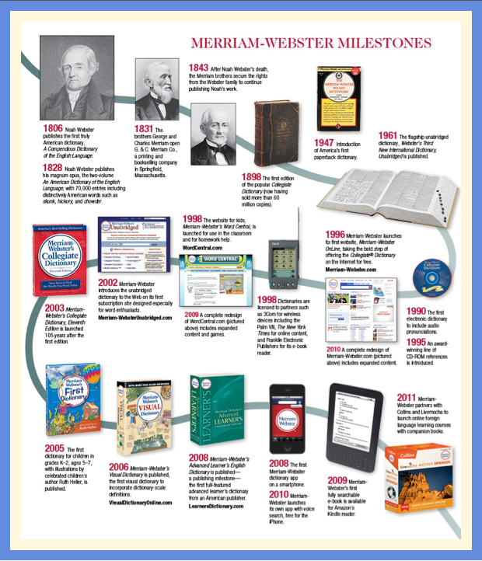
Frederick Douglass Annotated Timeline
Read:
Chaps intro-9: 9/15
Chaps 10-App: 9/29
Project Due: 10/2
Requirements:
16 point timeline detailing Douglass’ experiences via textual evidence (quotes with PC) in order of occurrence
All entries must be typed and turned into Turnitin.com
Each entry should be a minimum 5 sentences explaining:
What happened
Why this happened
The significance of what happened
include an appropriate, supporting visual

Slide 3
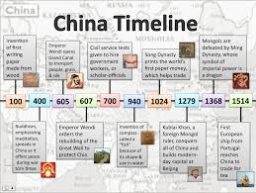
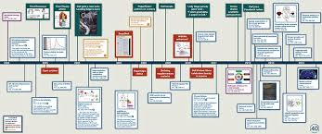
More Models
Interactive Timeline
Model

Slide 4
Who is Frederick Douglass?
Booktrailer for The Narrative of the Life of Frederick Douglass: An American Slave.

Slide 5
Animal Farm Propaganda Poster Due 10/30
Read:
Chaps 1-5 by 10/20
Chaps 6-10 by 10/27
Requirements:
Create a Propaganda Poster demonstrating one of the main character’s perspective on one of the issues raised in the text.
Be sure that the issue and perspective are both evident while including appropriate propaganda techniques.
Complete the Propaganda Poster Rationale Chart
Animal Farm Context

Slide 6
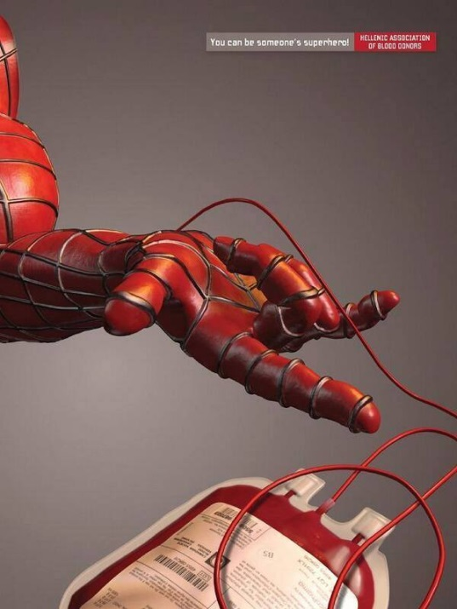
Propaganda Techniques
7 Propaganda Techniques with Examples

Slide 7
Lord of the Flies Diary
Read:
Chaps 1-7 by 11/27
Chaps 8-9 by 12/4
Finish by 12/11
Requirements:
Compose a 12 entry diary from the perspective of one character.
Each entry must be a minimum of 12 sentences and include a visual.
Maintain that character’s perspective throughout.
Be sure to include the major occurrences in the novel.

Slide 8
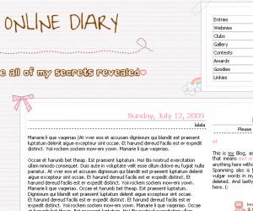
Online Diaries:
http://www.my-diary.org/
http://diary.com/
Blogs:
https://wordpress.com/
https://www.blogger.com/about/?r=1-null_user

Slide 9
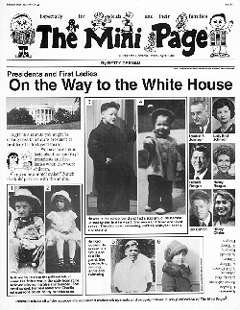
Bless Me Ultima Scrapbook or Newspaper
Read:
Chaps. 1-10 (pg. 82)- 1/26
Chaps. 11-14 (pg. 176)-2/2
Chaps. 15-22(pg. 262)-2/12
Requirement
Scrapbook
Include at least 8 pages reflecting the issues and situations of the novel – lots of visuals, key terms, feelings, major themes explained (at least 7 sentences per page)
Include multiple perspectives of characters
Include all major plot points
Mini Newspaper
Include at least 2 major (4 paragraphs each) articles related to the novel
4 minor (2 paragraphs each) articles related to the novel
Include visuals

Slide 10
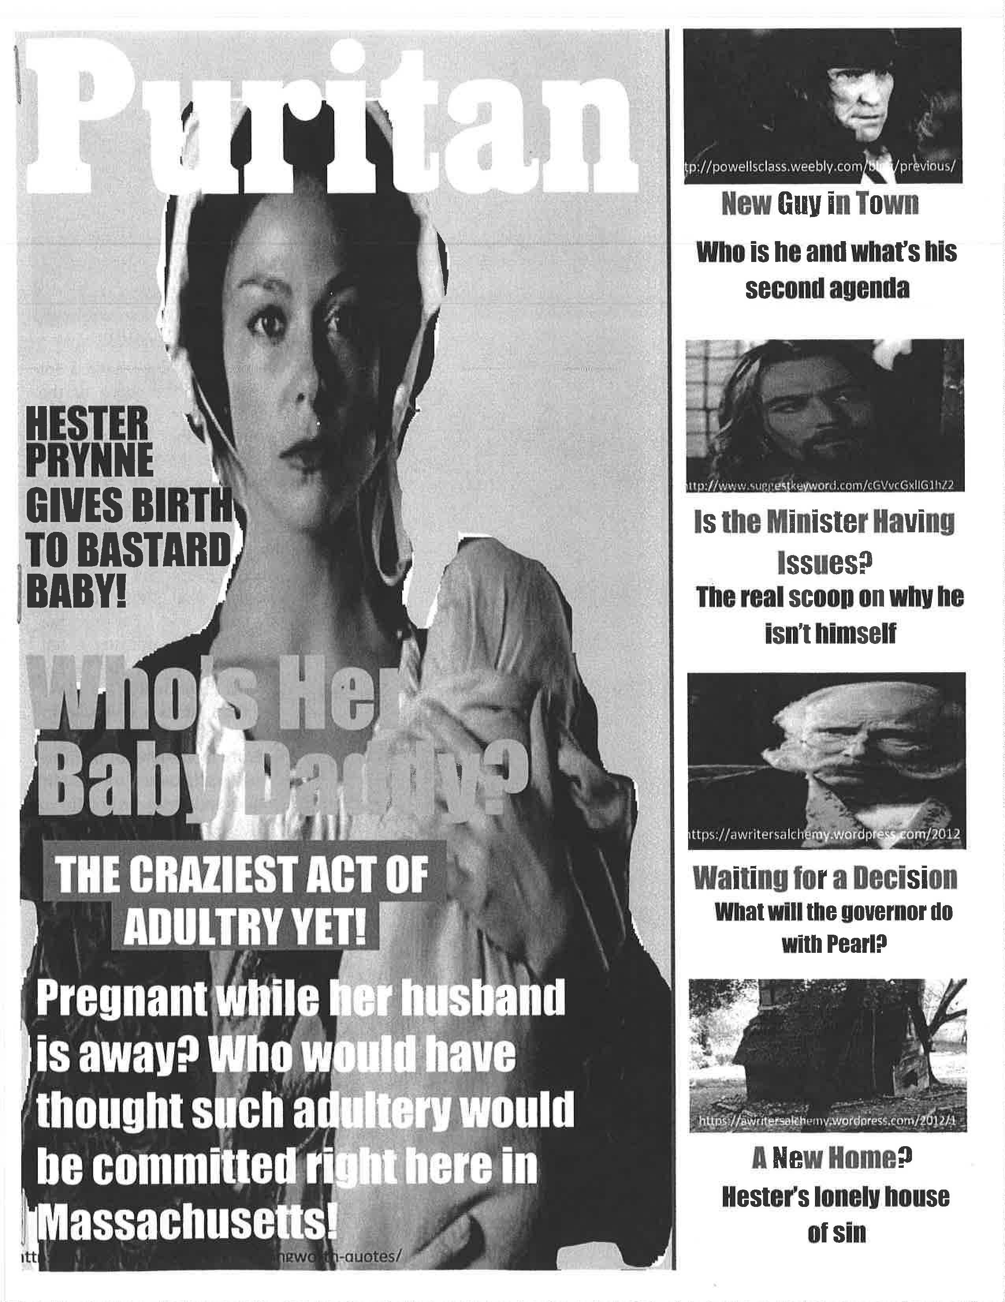
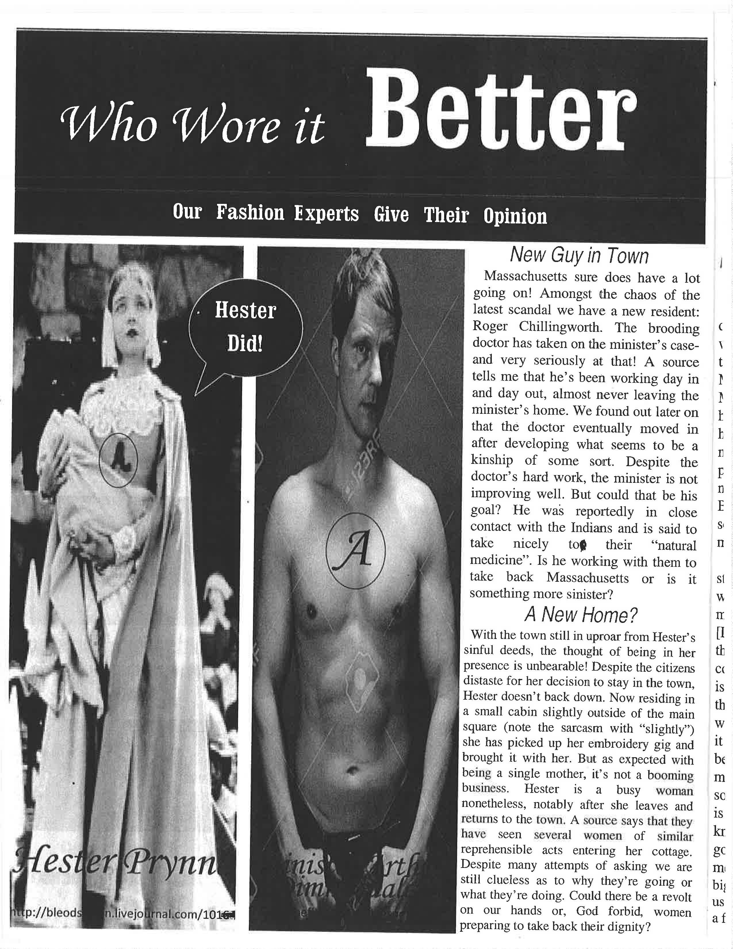
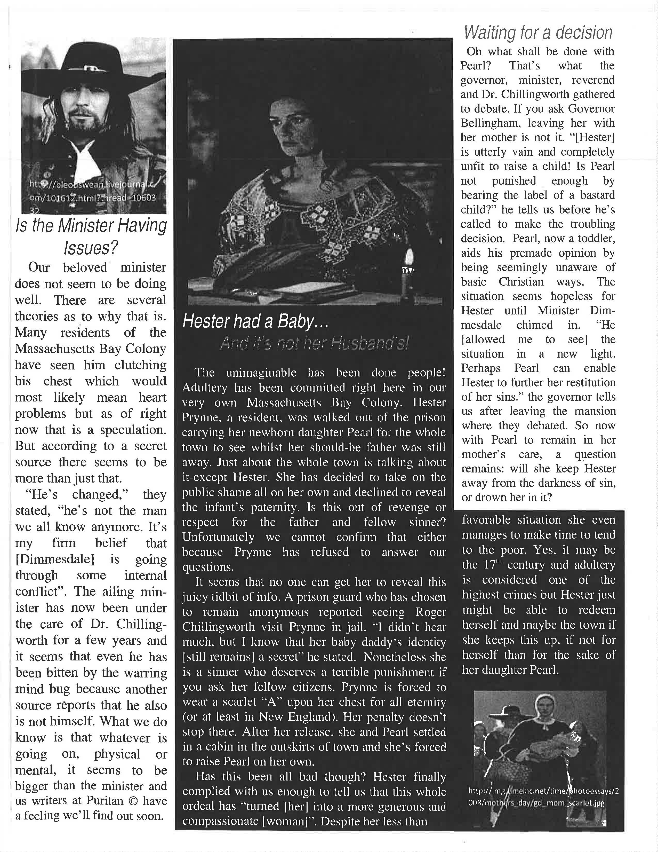
More examples

Slide 11
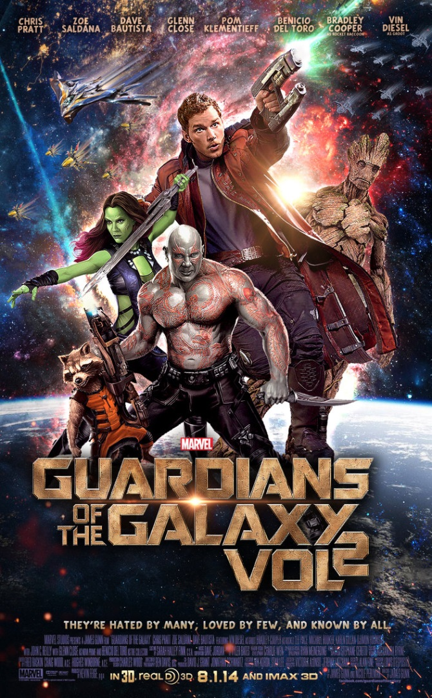
Julius Caesar Movie Plan
Read:
Act I (pg. 48) – 2/26
Act II (pg. 93) – 3/19
Act III-V (209)—4/10
Requirements:
Movie poster
Visual: symbol, pic of main characters, location
Director
Producer
Leading actors
Plan and Justification
Who would you cast for all of the main characters?
When and where would the story take place?
Which scenes would you keep? Leave out?
What 3 songs would you include in the score?
For each of these choices provide a written justification as to why this is an appropriate choice.
Iconic Movie Posters

Slide 12
Intro to Julius Caesar
Shmoop Video
Select one of the following quotes and argue for or against it.
You may also qualify. Use ROE (think SPRITE) to support your stance.
“The fault, dear Brutus, is not in our stars, but in ourselves.”
“Cowards die many times before their deaths; The valiant never taste of death but once. ”
“The evil that men do lives after them, The good is oft interred with their bones…”

Slide 13
Maus I &/or II Book Trailer
DUE: Wed June 6th
What is a book trailer?
A "trailer" is a brief video synopsis of a book or movie, designed to entice viewers to see the entire work. Your job is to create a Book Trailer for the novel your group read for independent reading.
Assignment Description:
brief introduction to setting, main characters, mood, theme
brief synopsis of story, or exciting scene
use of images, sound, video, text
a leading question or cliff hanger for the viewer to ponder (possibly entice them to read the book!)
overall time (2 ½ - 3 min)
More Tips: How to Make a Book Trailer

