Slide 1
Satire: The Oldest Trick in the Book
Satire's nature is to be one-sided, contemptuous of ambiguity, and so unfairly selective as to find in the purity of ridicule an inarguable moral truth.
E. L. DOCTOROW,
Creationists: Selected Essays

Slide 2
What is Satire?
The use of mockery, irony, humor, and/or wit to attack or ridicule something, such as a person, habit, idea, institution, society, or custom that is, or is considered to be, foolish, flawed, or wrong.
The aim of satire is, or should be, to improve human institutions and/or humanity.
Satire attempts through humor and laughter to inspire individuals, institutions, and humankind to improve or to encourage its readers to put pressure on individuals and institutions so that they may be improved for the benefit of all.
The best satire does not seek to do harm or damage by its ridicule, unless we speak of damage to the structure of vice, but rather it seeks to create a shock of recognition and to make vice repulsive so that the vice will be expunged from the person or society under attack or from the person or society intended to benefit by the attack (regardless of who is the immediate object of attack); whenever possible this shock of recognition is to be conveyed through laughter or wit:
the formula for satire is one of honey and medicine.

Slide 3
Satirical Techniques
Exaggeration/Hyperbole:
making a small blemish bigger or a hidden vice or folly or to the target itself. Some specific types of exaggeration include the outrageous suggestions and proposals which often characterize satirical pieces and the writer’s exaggeration of the customary diction and syntax of an individual, an agency, a text, or a publication.
Distortion:
twisting or emphasizing some aspect of a condition, individual, or event tends to highlight it. A type of distortion may include the juxtaposition of inappropriate or incongruous ideas or things.
Understatement:
when the folly or evil is so great that further exaggeration is impossible, understatement shows its true extent.
Innuendo
is a valuable tool for the satirist because it allows him to implicate a target by a completely indirect attack. This is especially useful when the target is dangerous, for itis often possible to deny the insinuation.
Use of silly or inherently funny words
like “newt” and “nostril” can enhance satire.

Slide 4
Satirical Techniques
Invective:
a speech that criticizes someone or something fluently and at length. This technique may also be called a diatribe or rant. Famous example: “A knave, a rascal, an eater of broken meats; a base, proud, shallow, beggarly, three suited, hundred-pound, filthy worsted-stocking knave
The list:
something highly important or even sacred may be included in a long list of
mundane and ordinary objects in order to highlight the fact that an individual, institution,
or society has lost its sense of proportion.
Oxymoron
used satirically makes for a pointed emphasis on some contradiction in the
target's philosophy.
Parable and allegory
have the same benefits as simile and metaphor, for they can
conduct a prolonged discussion on two levels of meaning while at the same time
inherently comparing and contrasting those levels without further comment. They also
provide the author with some defense if the subject is dangerous, for the satirist can
protest that he/she was writing only on the literal level. Famous examples of this
technique are Gulliver’s Travels by Jonathan Swift and Animal Farm by George Orwell.
Sarcasm and verbal irony
are often employed as tools of satire, as well.

Slide 5
It is perhaps by now apparent that almost all of these techniques have one element in common: each provides a way to say two or more things at one time, and to compare, equate, or contrast those things, usually with heavy irony.
-Robert Harris

Slide 6
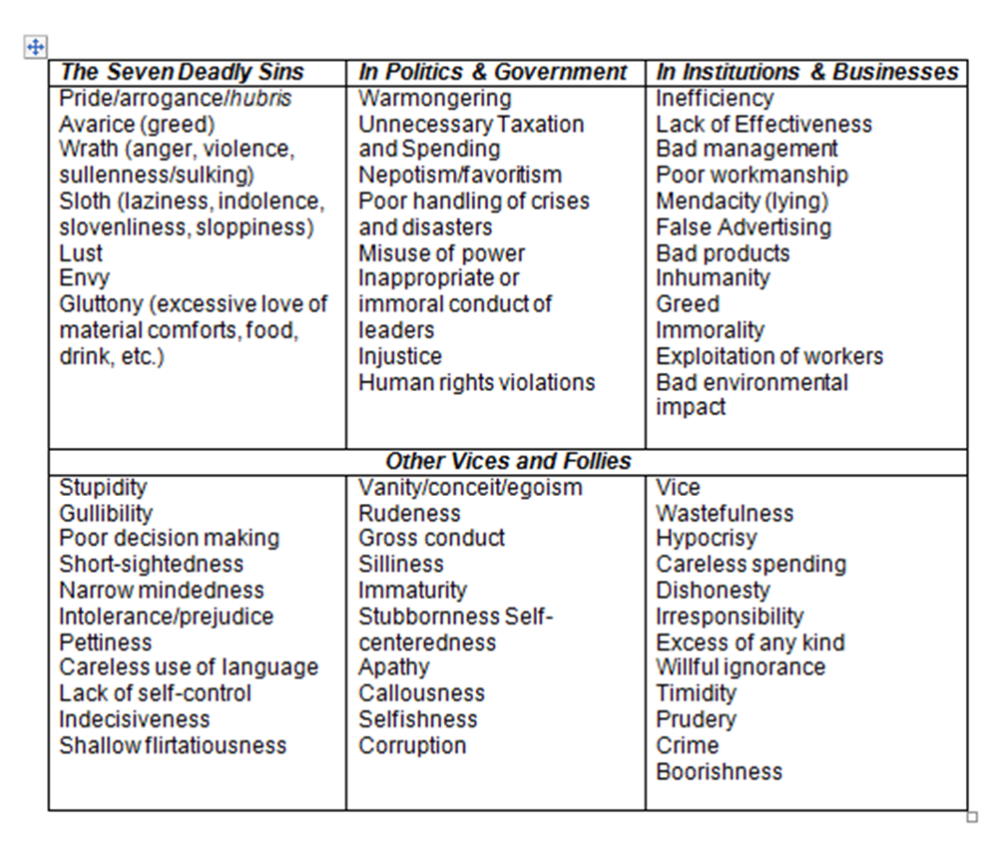
What gets ridiculed? Vices and Follies

Slide 7
SNL Examples
The Day Beyonce Turned Black SNL
The Bubble SNL
Totinos Super Bowl Ad

Slide 8
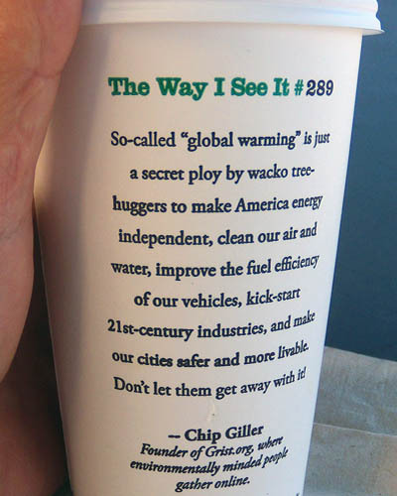
Satire in Society
From Starbucks’ “The Way I See It” Campaign #289
So –called “global warming” is just a secret ploy by wacko tree-huggers to make America energy independent, clean out our air and water, improve the fuel efficiency of our vehicles, kick-start 21st century industries, and make our cities safer and more livable. Don’t let them get away with it!
-Chip Giller Founder of Grist.org, where environmentally minded people gather online.

Slide 9
Satire Analysis Model
So –called “global warming” is just a secret ploy by wacko tree-huggers to make America energy independent, clean out our air and water, improve the fuel efficiency of our vehicles, kick-start 21st century industries, and make our cities safer and more livable. Don’t let them get away with it!

Slide 10
Your Turn Rhetoricians!
Satirical Amazon Reviews
Now, in your small group, go to Amazon and find a product that’s just begging to be ridiculed & compose a satirical review.
Turn in your review here:
Satirical Amazon Reviews 2018 Period 1
Satirical Amazon Reviews 2018 Period 2

Slide 11
HW: The Onion, “Wealthy Teen…” Satire Acronym Graphic Organizer
Subject Matter: What is the passage about?
Attack: Who/what is the focus of the attack/ridicule?
Tone: What is the author’s attitude toward the subject under attack?
Implications: What outcome can we expect if the change occurs?
Reform: What change is the author seeking?
Evidence: What textual evidence supports your analysis?

