Slide 1
Rhetorical Analysis infographic
SPEECH CHOICES

Slide 2

“Rice stadium Moon speech”
President John Fitzgerald Kennedy
The "Address at Rice University on the Nation's Space Effort", or better known simply as the "We choose to go to the moon" speech, was delivered by U.S. President John F. Kennedy in front of a large crowd gathered at Rice University in Houston, Texas on September 12, 1962. It was one of Kennedy's earlier speeches meant to persuade the American people to support the effort of NASA to send a manned space flight to the moon.

Slide 3
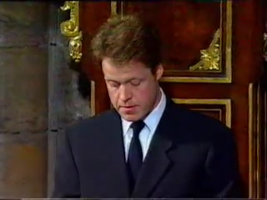
“The most hunted person of the modern age”
Earl Spencer
In 1997 at the funeral of Princess Diana, her brother, Earl Spencer, delivered a eulogy honoring his late sister while simultaneously attacking the media and paparazzi for their treatment of the Princess, calling her the “most hunted person of the modern age.”

Slide 4
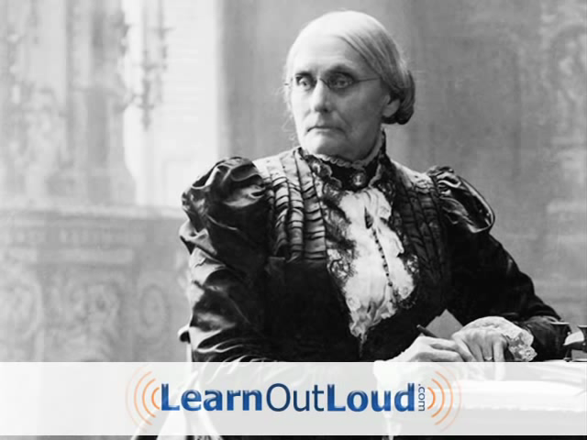
“Women’s Right to the Suffrage”
Susan B. Anthony
In the 1800s, women in the United States had few legal rights and did not have the right to vote. This speech was given by Susan B. Anthony after her arrest for casting an illegal vote in the presidential election of 1872. She was tried and then fined $100 but refused to pay.

Slide 5
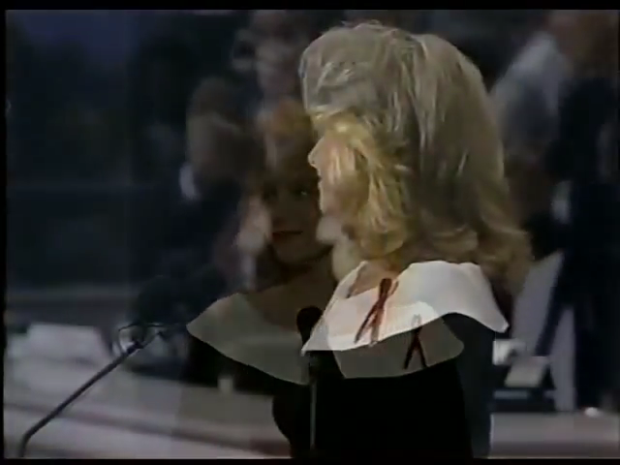
“A Whisper of AIDS”
Mary Fisher
Mary Fisher, a mother of two and diagnosed HIV Positive, speaks at the Republican National Convention in 1992 about the reality of the spreading AIDS/HIV infection. Urging her party to action on an issue largely ignored, Fisher provides her life as an illustration of HIV positive-individuals across the country.

Slide 6

“My Brother’s Keeper”
BARACK OBAMA
IN 2004 THE THEN JUNIOR SENATOR FROM ILLINOIS DELIVERED THE KEYNOTE ADDRESS AT THE DEMOCRATIC NATIONAL CONVENTION IN BOSTON. THE SPEECH TRANSFORMED PRESIDENT OBAMA FROM A VIRTUAL UNKNOWN FIRST TERM SENATOR TO A CANDIDATE FOR THE PRESIDENT OF THE UNITED STATES.
Annotate for

Slide 7
“Gender equality is your issue too”
Emma Watson
IN RECENT YEARS THE FIGHT FOR GENDER EQUALITY HAS CROSSED GENDER LINES AND MANY BOYS AND MEN HAVE BEGUN TO RAISE THEIR VOICES IN SOLIDARITY WITH THE MOVEMENT. IN THIS SPEECH UN WOMEN GOODWILL AMBASSADOR EMMA WATSON LAUNCHES THE 'HEFORSHE' CAMPAIGN, TALKING ABOUT HER EXPERIENCE AND VIEWS ON FEMINISM AND EQUALITY.

Slide 8
“After Dropping the Bomb on Hiroshima”
President Harry s. Truman
TRUMAN APPROVED THE DROPPING OF ATOMIC BOMBS ON THE JAPANESE CITIES OF HIROSHIMA (ON AUGUST 6) AND NAGASAKI (ON AUGUST 9). JAPAN’S SURRENDER WAS ANNOUNCED ON AUGUST 14, 1945; HOWEVER, TRUMAN’S USE OF THE ATOMIC BOMB CONTINUES TO BE ONE OF THE MOST CONTROVERSIAL DECISIONS OF ANY AMERICAN PRESIDENT. IN THIS SPEECH TRUMAN INFORMS THE UNITED STATES OF HIS DECISION.

Slide 9
“HUMAN TRAFFICKING”
ASHTON KUTCHER
IN A PLEA TO CONGRESS, CELEBRITY AND NOW HUMAN TRAFFICKING ADVOCATE ASHTON KUTCHER GIVES HIS TESTIMONY ON THE IMPORTANCE OF FUNDING FOR HUMAN TRAFFICKING IN DISCUSSING HIS NEWLY FOUNDED ORGANIZATION.

